Slide 1
http://github.com/krastoss/JavaTeamwork

Slide 2

Pig ninja vs androids
Java Basics Teamwork, team AEROBLUE
SoftUni, September 2014

Slide 3
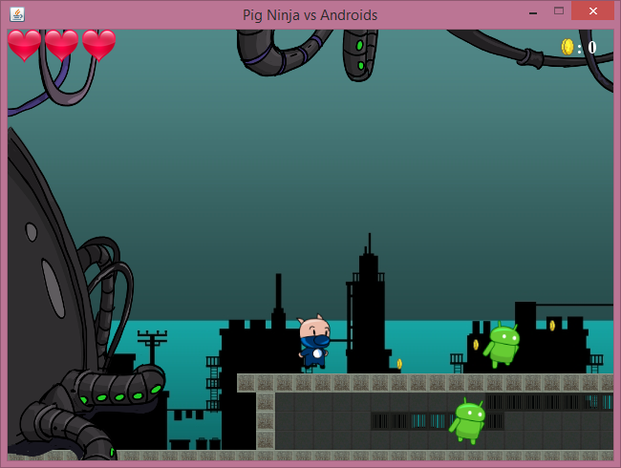
Project name and purpose
Name – “Pig Ninja vs Androids”
Game type – 2D Java Platformer

Slide 4
AEROBLUE MEMBERS
Velizar Bishurov (vbishurov) - programming
Deivid Raychev (Gleomit) - programming
Krastyo Krastev (krastevkrs) - design and coordination
Nikolay Draganov (NikolayDraganov) - support
Todor Atanasov (atanasovam) - support

Slide 5

Tools and resources
GitHub
http://github.com/krastoss/JavaTeamwork
SWING and AWT
Sprites
Facebook, Skype

